Slide 1

Jermyn Borough Council Meeting
12/17/20
This Photo by Unknown Author is licensed under CC BY-NC

Slide 2
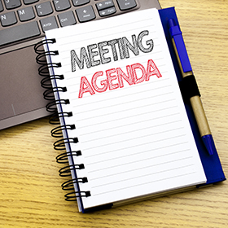
Meeting Agenda
Call to Order
Pledge of Allegiance
Roll Call
Moment of Silence for Donald Stephens
Previous Meeting Minutes
Council Seat Appointment
Resolution #21-2020 – New Council Member
Swearing in of New Council Member
Treasurer’s Report/Bills Payable
Correspondence
Public Comment
Professional Reports
Committee Reports
Borough Manager Report
Delinquent Garbage Fees
Capstone Project
Annual Auditor Appointment for 2020 Annual Audit
Resolution #22-2020 – Appointing Borough Auditor for 2021
New Business
Adjournment

Slide 3
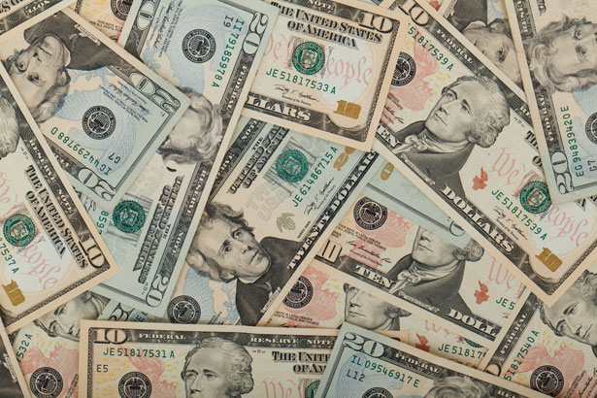
Treasurer’s report
December 17, 2020
ASSETS
Capital Reserve - DPW 13,497.05
Capital Reserve - Police 3154.28
Crime Watch Fund 755.44
General Fund - Community 181,584.93
General Fund - FNB 1,975.99
Holiday Lights Fund 543.90

Slide 4
Treasurer’s report
Investment - General Fund 1001.39
Investment - Liquid Fuels 33,806.66
Investment - Paving Fund 11.91
Investment - Recycling 5,002.59
Investment - Refuse 2,604.51
Liquid Fuels - FNB 28,933.69
Petty Cash 171.42
Recreations Fund 8803.12
Recycling - Community 9,109.37
Refuse Checking - FNB 36,378.64 Total Checking/Savings 327,334.89

Slide 5
TREASURER’S REPORT
Accounts Payable 127,250.81

Slide 6


